Slide 1
Restoration Advisory Board Meeting
May 17, 2017

Slide 2
Agenda
Review/Accept January 11th Meeting Minutes
Connecticut River Sampling Update
Soil Vapor Extraction Pilot at AOC 9 and AOC 2
Upcoming Work
Draft Final Remedial Investigation Report
Schedule Next Meeting
Adjourn

Slide 3
Connecticut River Sampling
Purpose: Investigate legacy TCE contamination due to July 1970 release from tank explosion at AOC 9
Tank contained 5,000-6,000 gallons
Approximately 3,000 gallons were spilled over the parking area surface
Unknown volume washed into storm drain system and discharged to the river at the CRREL outfall (Faran, 1991)

Slide 4
Connecticut River Sampling (cont)
Advanced 26 sediment/soil borings from 5 to 65 feet below the river bottom
150 sediment/soil samples collected and analyzed for volatile organic compounds
Advanced 3 rock core borings, each 25 feet into bedrock
18 rock samples from the rock cores crushed and analyzed for volatile organic compounds
Collected 6 surface water samples

Slide 5
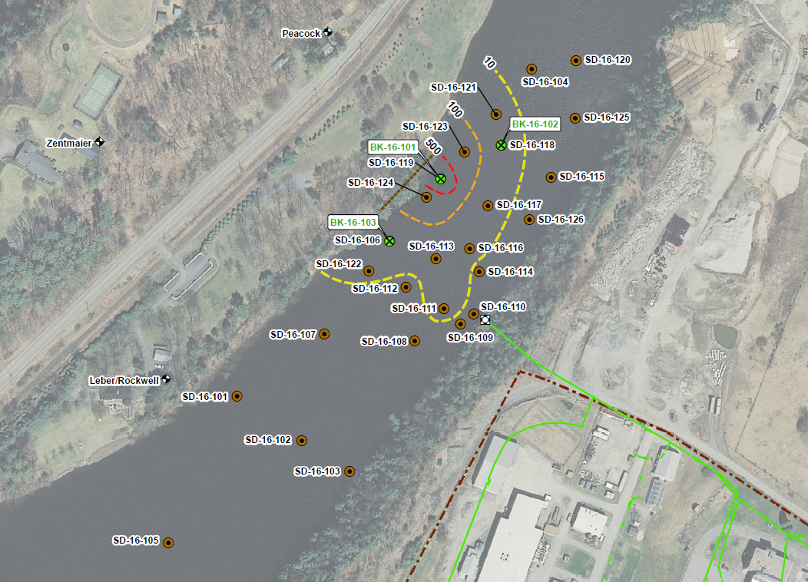

Slide 6
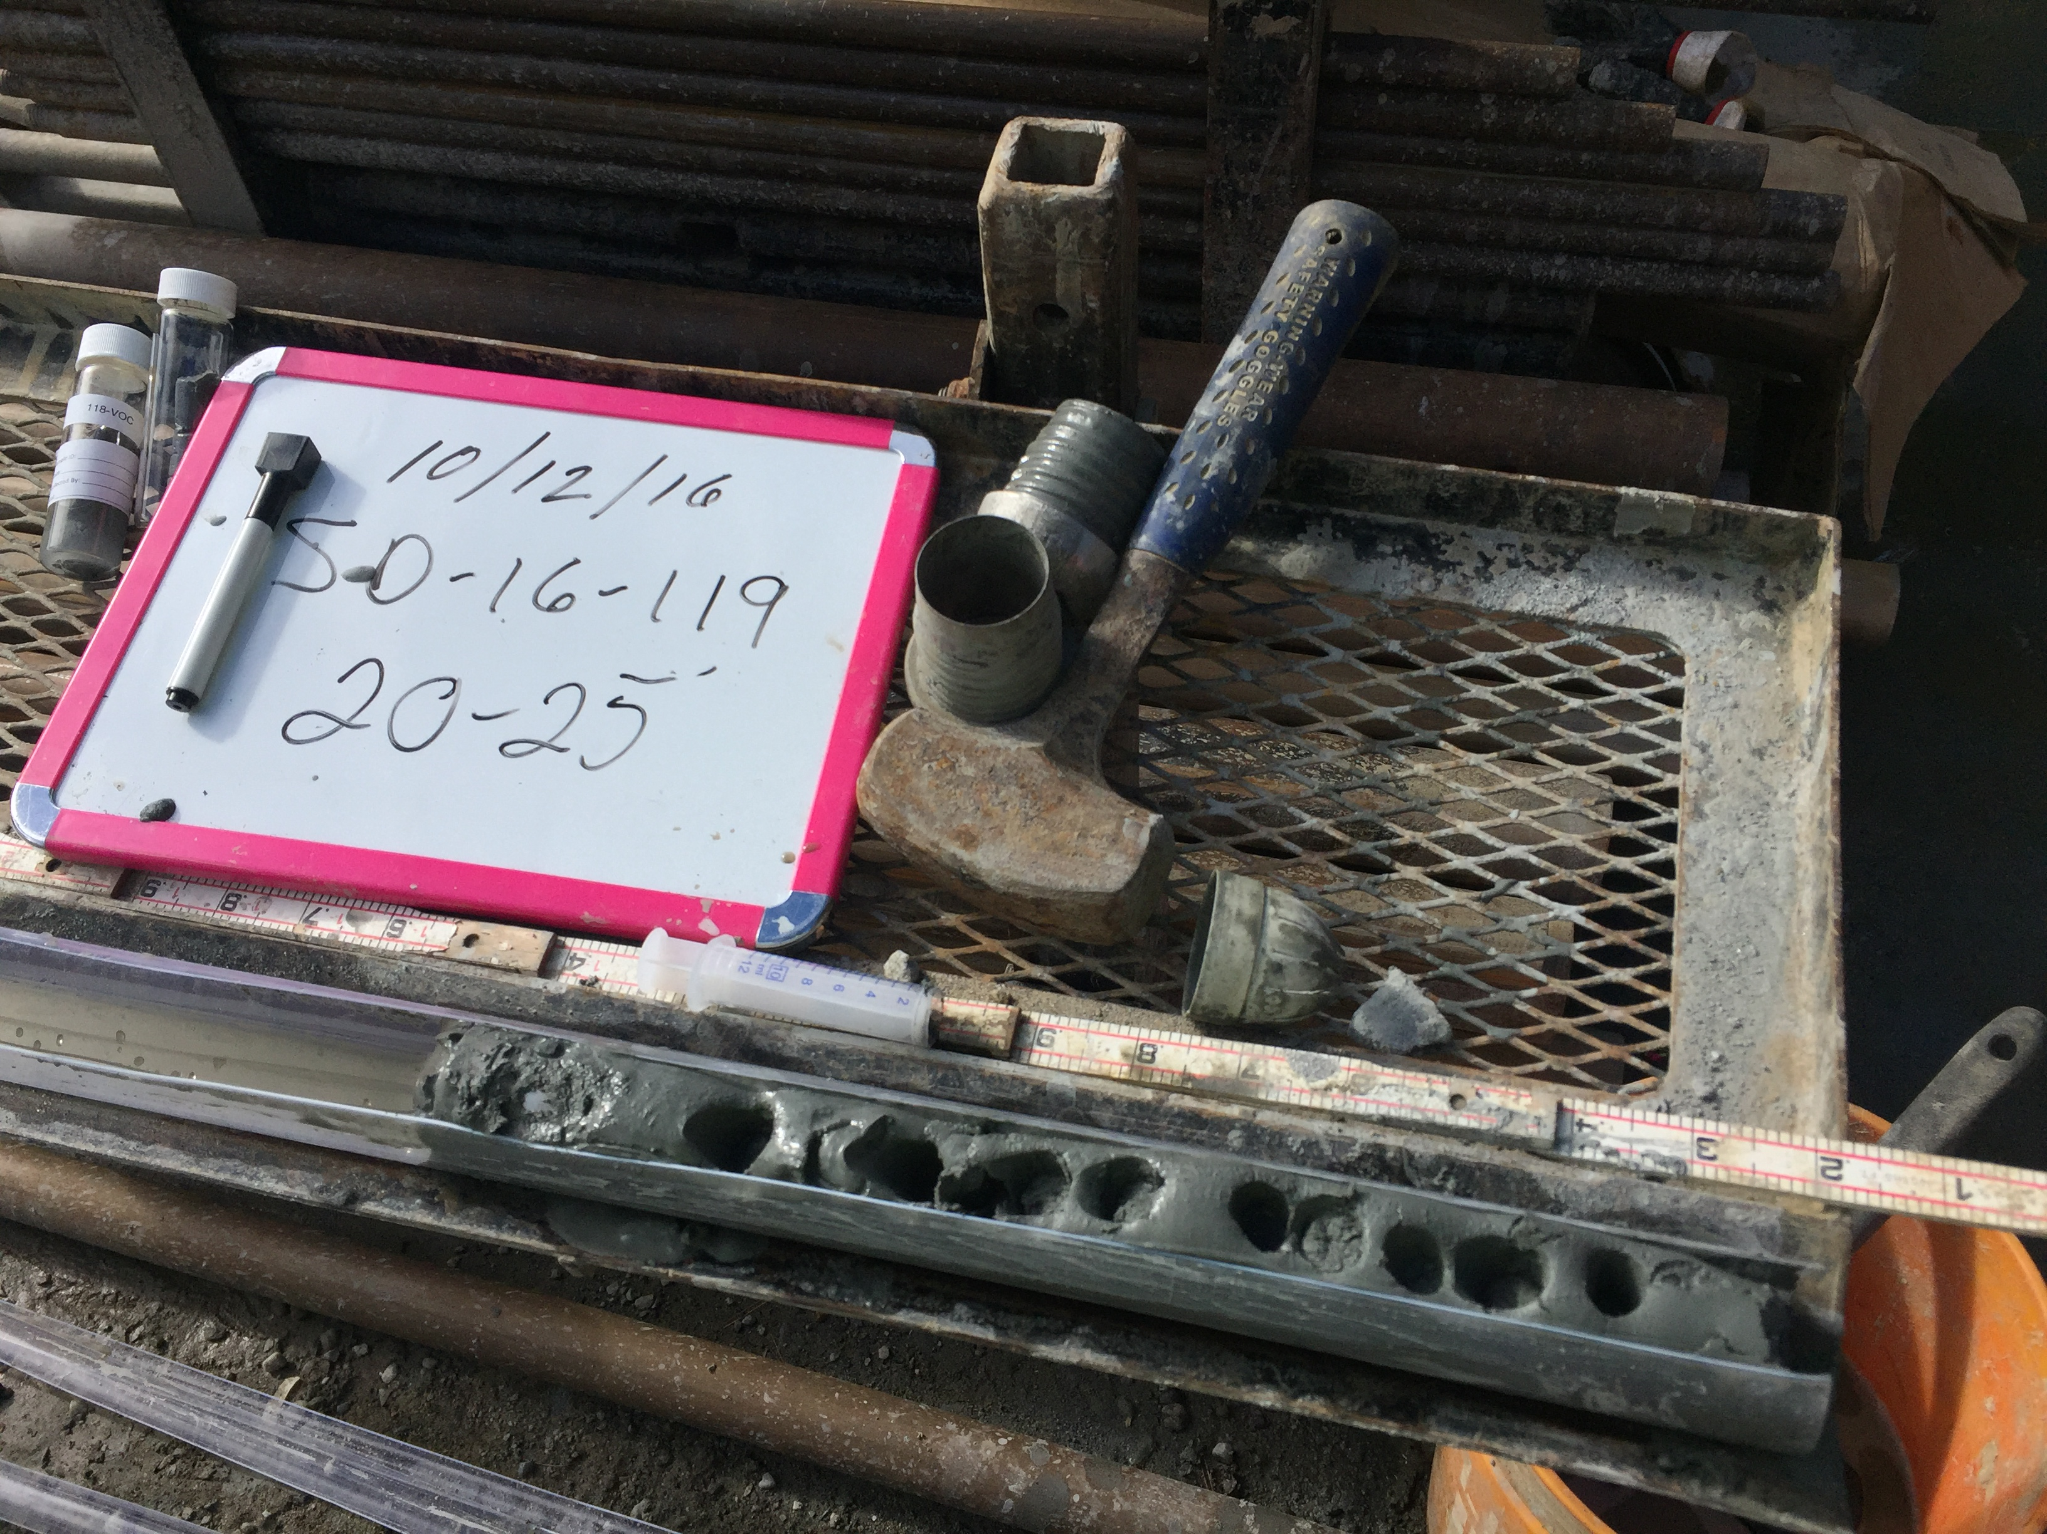
Till Overlying Bedrock

Slide 7
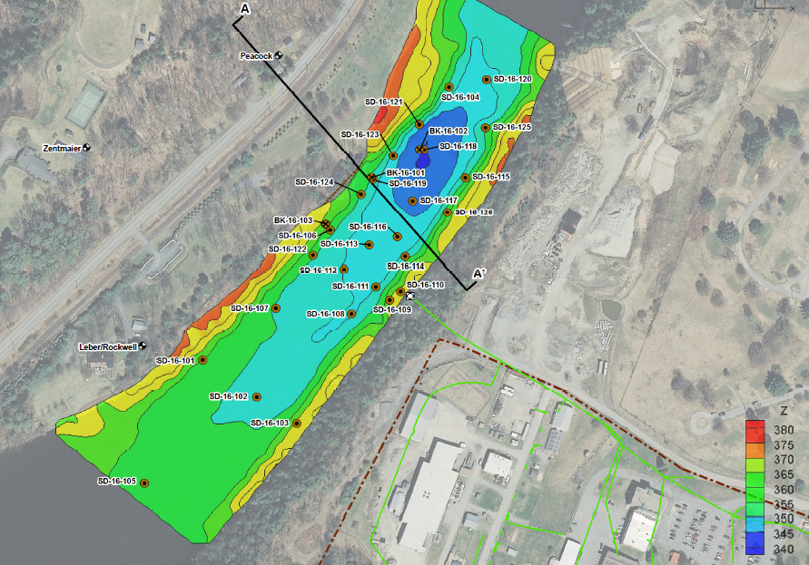
River Cross Section Location

Slide 8
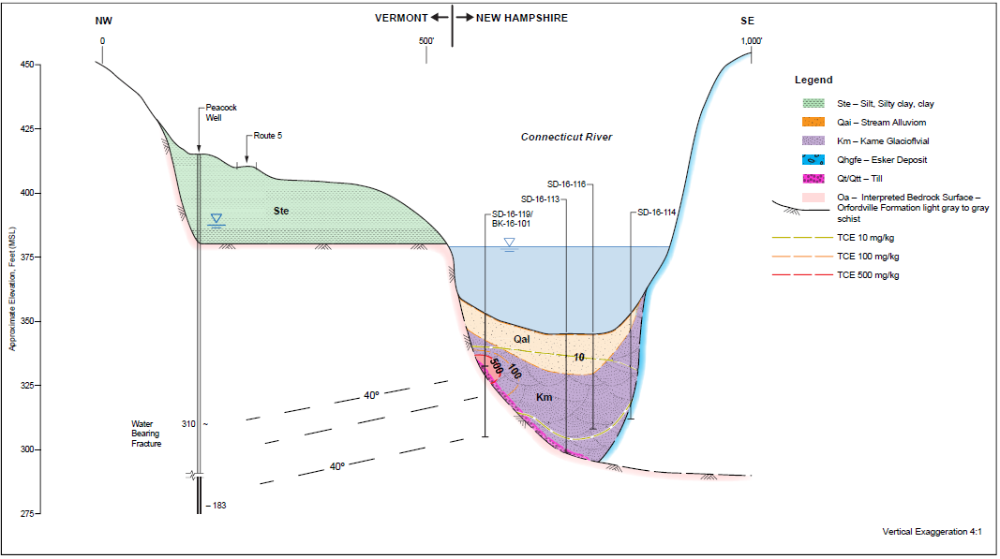
Draft River Cross Section

Slide 9
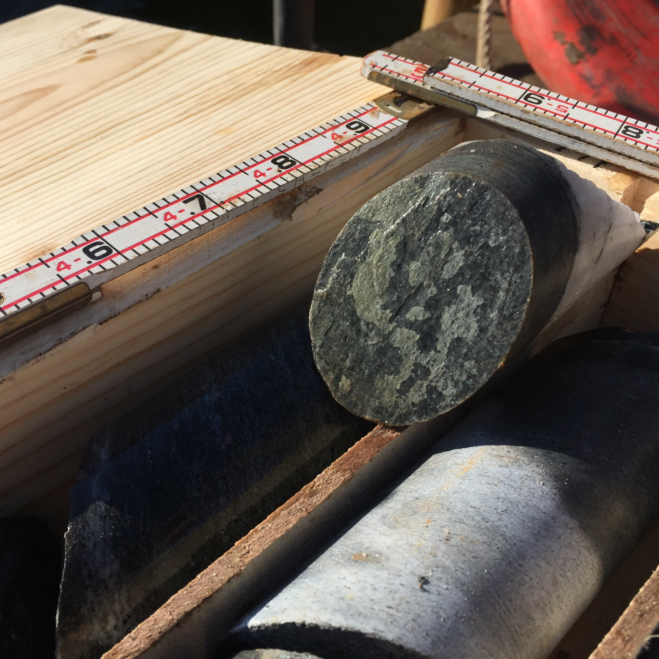
Connecticut River Sampling Summary
TCE Hotspot on western shore of the Connecticut River.
Hotspot overlies bedrock approximately 20 feet below the bottom of the river.
Rock matrix sampling shows bedrock is non-detect for VOCs
No evidence for matrix diffusion out of rock to bedrock groundwater.
Surface water samples non-detect for VOCs.

Slide 10
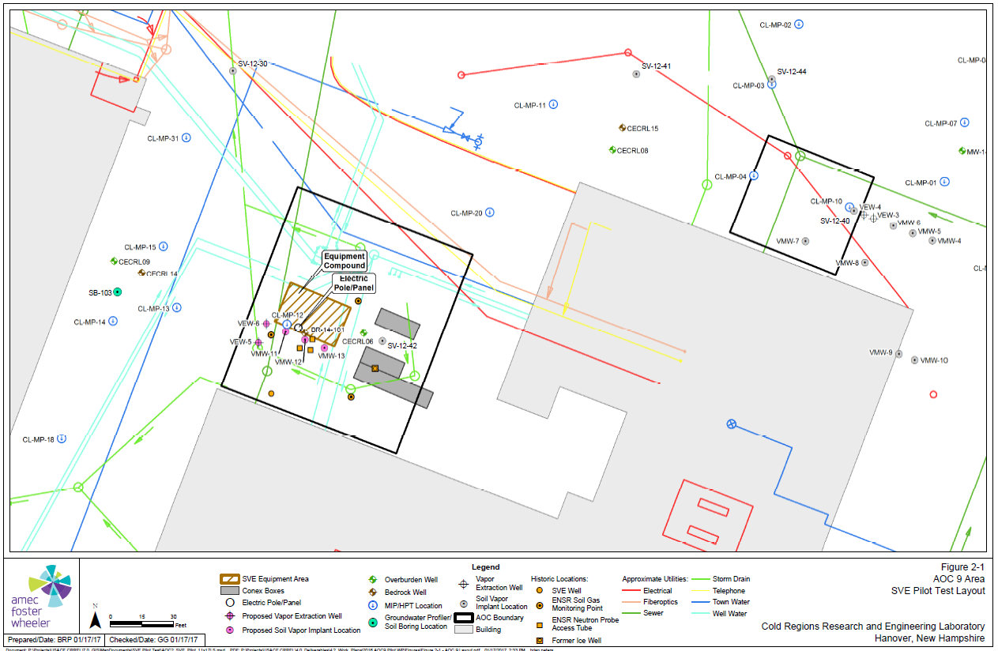

Slide 11
Soil Vapor Extraction Pilot Study Update
  SVE Pilot ran from June 2015-August 2016 at AOC 2
  Approximately 450 gallons of TCE removed by the SVE Pilot System.
  SVE Pilot at AOC 2 resumed on April 19th with carbon treatment.
  SVE Pilot at AOC 9 commenced on March 8th, will run for 6 months.
  Approximately 35 gallons of TCE have been recovered over 45 days (~0.75 gallons per day).
  Results from AOC 9 and carbon equipment at AOC 2 will be used for the design of an Interim Measure

Slide 12
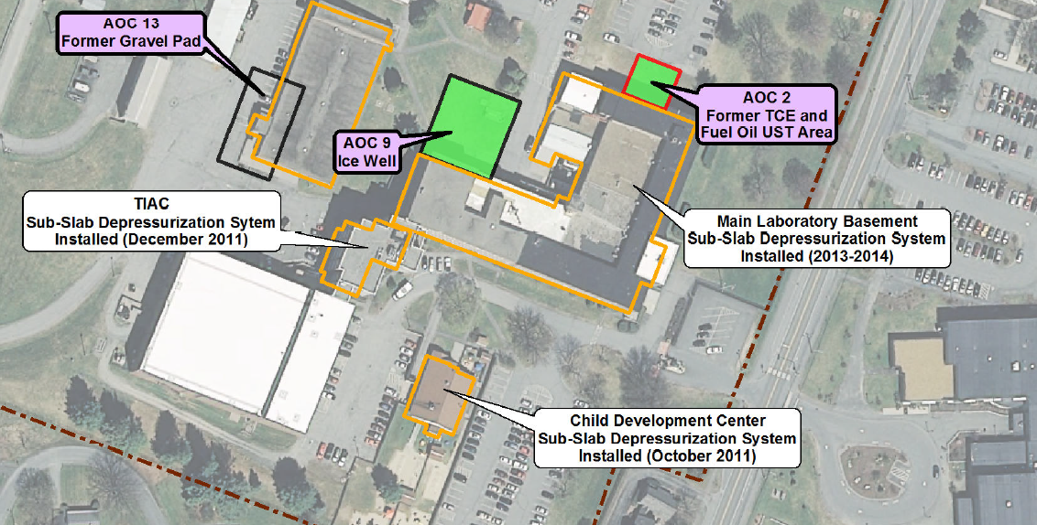
SVE Effects on Sub-Slab Influent Air

Slide 13
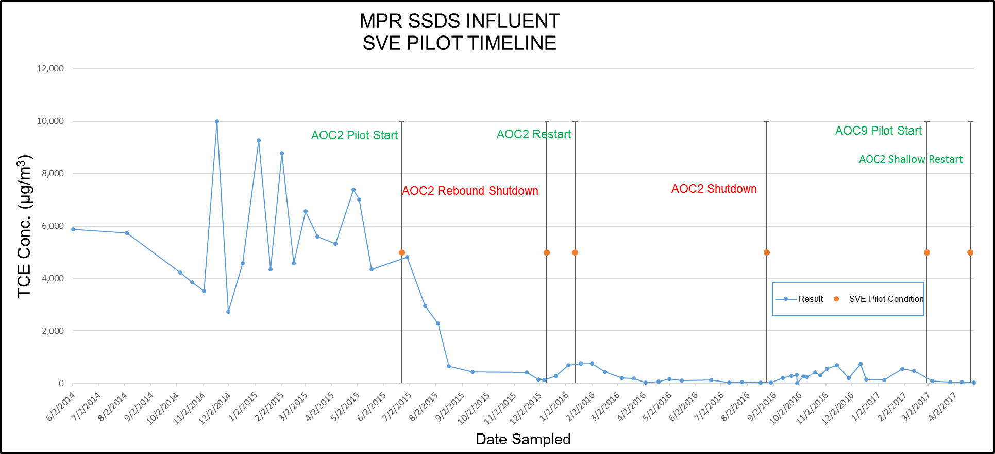
SVE Pilot Test - Effects on Sub-Slab Depressurization Influent TCE Concentrations

Slide 14
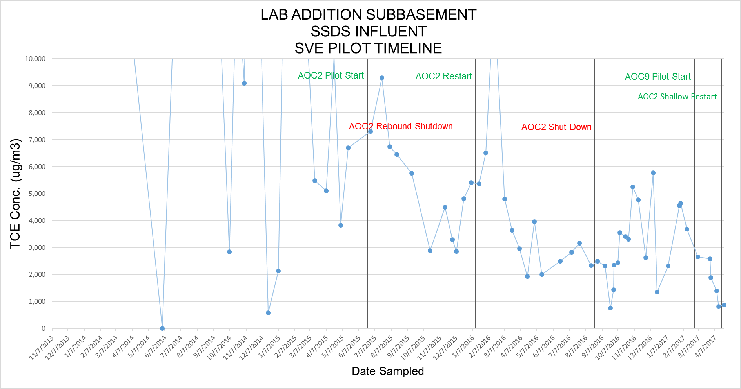
SVE Pilot Test - Effects on Sub-Slab Depressurization Influent TCE Concentrations

Slide 15
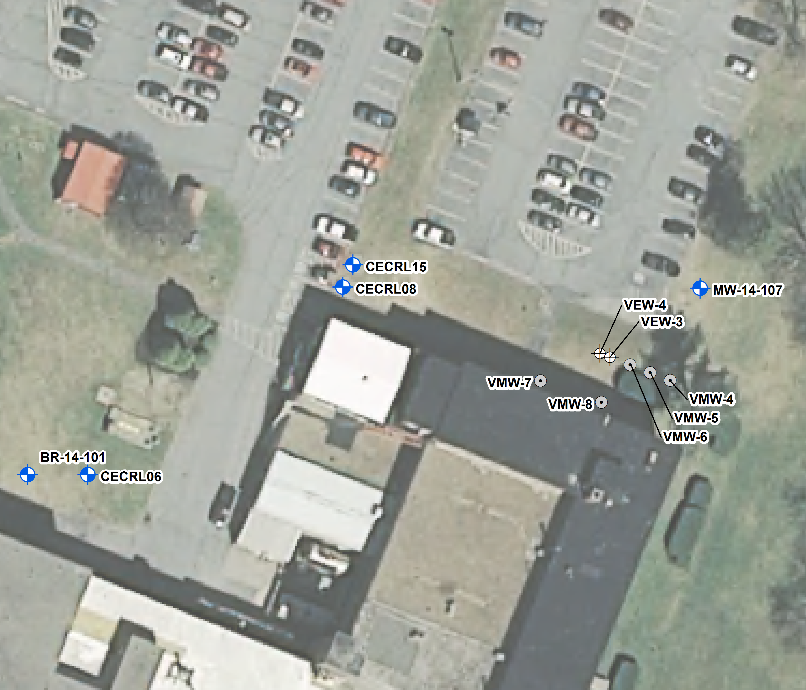
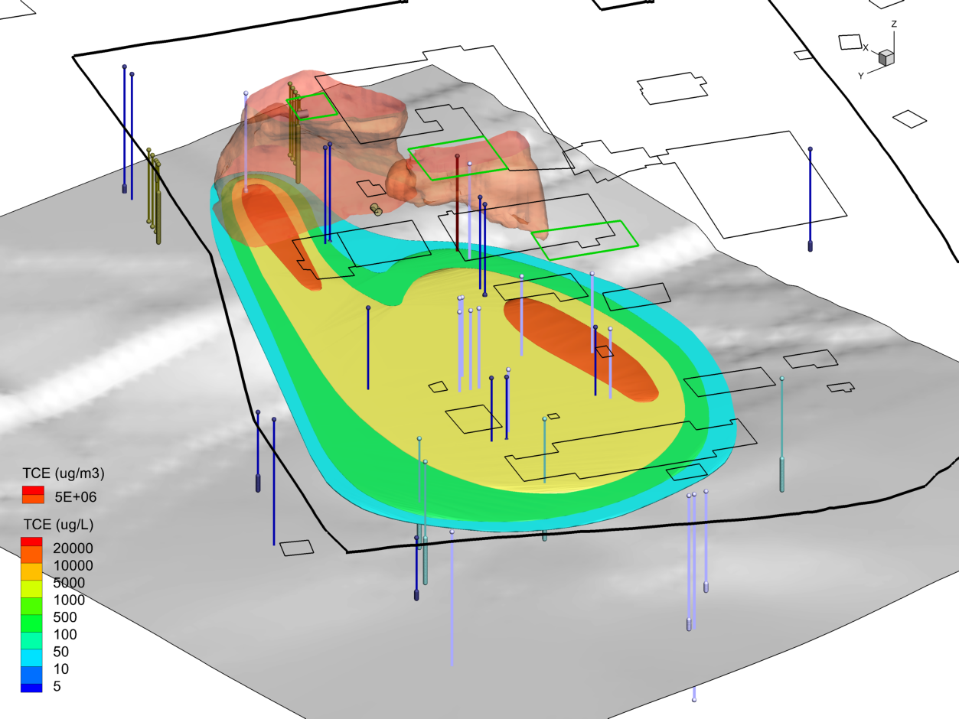
SVE Effects on Groundwater

Slide 16
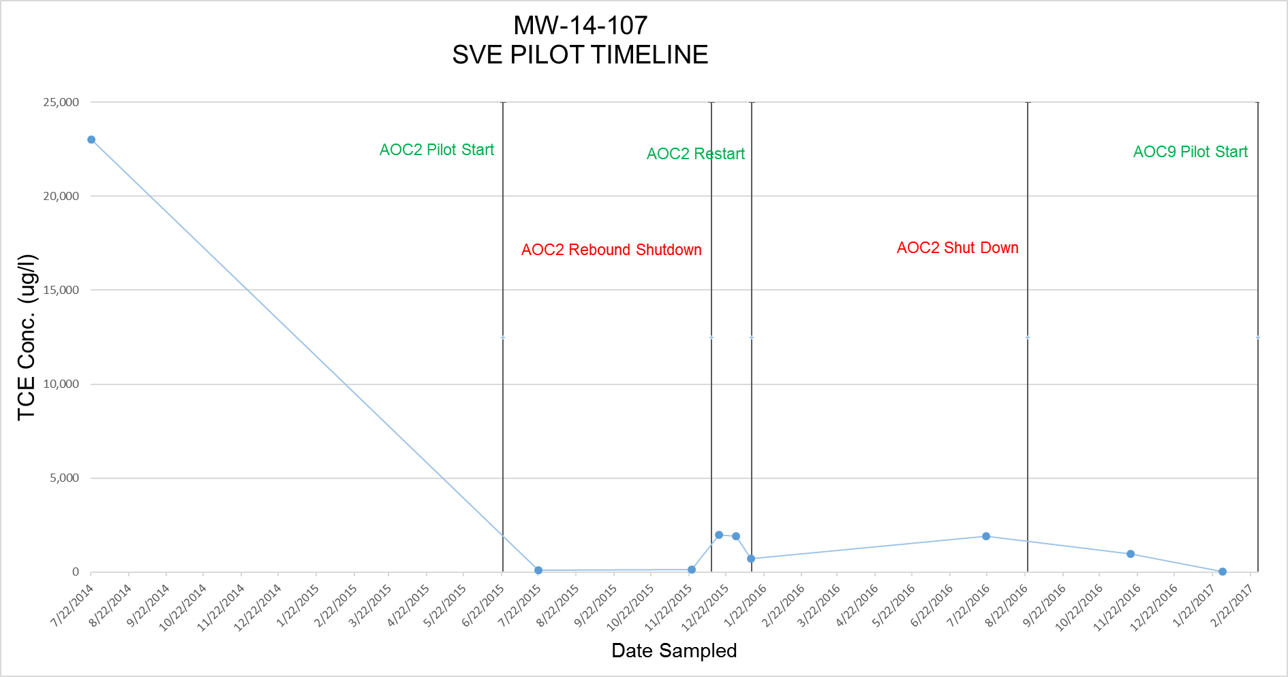
SVE Pilot Test - Effects on Overburden Groundwater TCE Concentrations

Slide 17
Soil Vapor Extraction Pilot Test Goals
Determine operational differences between AOC 2 and AOC 9
Evaluate if SVE operation in AOC 9 can reduce sub-slab concentrations beneath the Main Lab and Sub-basement
Determine optimum well screen placement for future extraction wells at AOC 9
Further evaluate SVE effects on TCE groundwater concentrations
Continue operation at AOC 2 to control soil gas migration and reduce vapor intrusion

Slide 18
What will we be working on?
Continue to monitor indoor air at CRREL with HAPSITE®
Aquifer Pilot Test May/June 2017
Off-site soil gas implant installs June 2017
Indoor Air Event 16 August 17th -19th and 23rd-25th, 2017
Draft FS Report August/September 2017
Run AOC 2 and AOC 9 SVE Pilot to early September 2017
Finalize RI Report October/November 2017

Slide 19
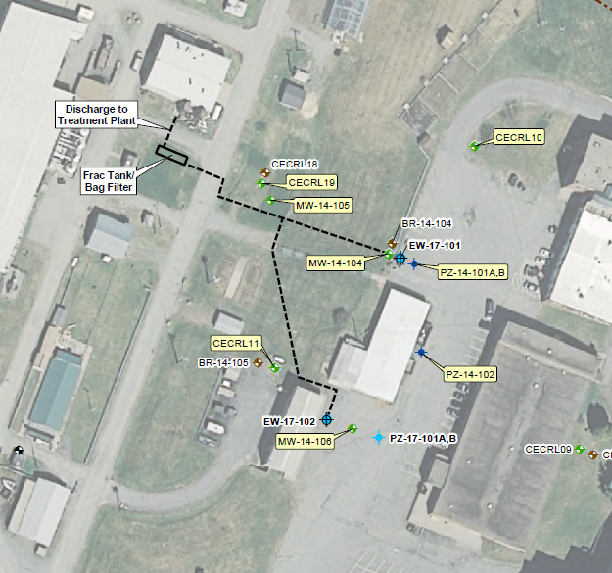
Aquifer Pilot Test

Slide 20
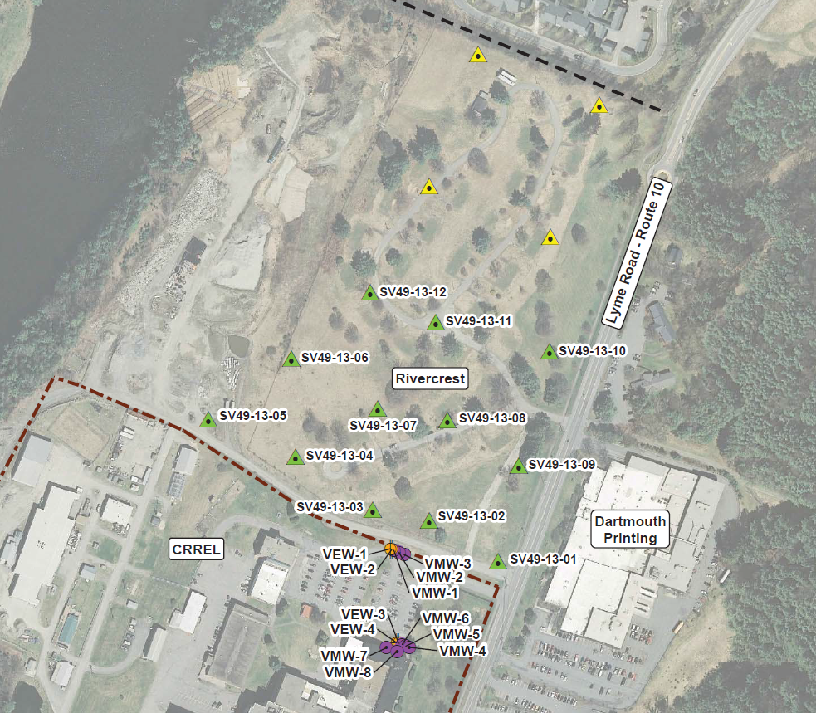
Rivercrest Soil Gas Implants

Slide 21
Remedial Investigation Report
Document reviewed by
  COE NAE
  Installation Restoration Program Manager
  Army Public Health Center
  Environmental and Munitions Center of Expertise
COE NAE submitted the Draft Final RI to the NHDES and the VTDEC for review and comment on May 9th.
Forty-five day review and comment period.

Slide 22
Remedial Investigation Objectives
Characterize sources, nature, and extent of contaminants.
  historical data
  recent results from 2011 to 2015
  defensible analytical data for air, surface soil, subsurface soil, bedrock matrix, and groundwater
Assess potential human health and ecological risks associated with environmental media at AOCs consistent with DoD, federal (CERCLA) and state requirements.
Provide sufficient information for development of a Feasibility Study (FS) for evaluation of clean up alternatives.

Slide 23
Scope of the RI Work
31 membrane interface probes advanced.
11 soil borings advanced and 246 soil samples collected.
36 shallow auger borings and 38 soil samples collected.
22 deep groundwater profile locations advanced and 261 water samples collected.
5 deep overburden and 5 bedrock wells installed and sampled.

Slide 24
Scope of the RI Work (cont.)
8,000+ vapor intrusion air samples collected.
500+ soil gas samples collected.
Aquifer pilot test.
Numerous work plans and interim reports.
Remedial Investigation Report.
  Human Health Risk Assessment.
  Ecological Risk Assessment.

Slide 25
RI Outline
Executive Summary
Section 1 – Introduction
Section 2 – Previous Investigations and Phase III Investigation
Section 3 – Physical Description
Section 4 – Nature and Extent of Contamination
Section 5 – Conceptual Site Model

Slide 26
RI Outline (cont)
Section 6 – Applicable or Relevant and Appropriate Requirements
Section 7 – Human Health Risk Assessment
Section 8 – Ecological Risk Assessment
Section 9 – Preliminary Remediation Goals
Section 10 – Summary and Conclusions
Figures, Tables and Appendices (thumb drive)
Appendix U (Human Health Risk Assessment)

Slide 27
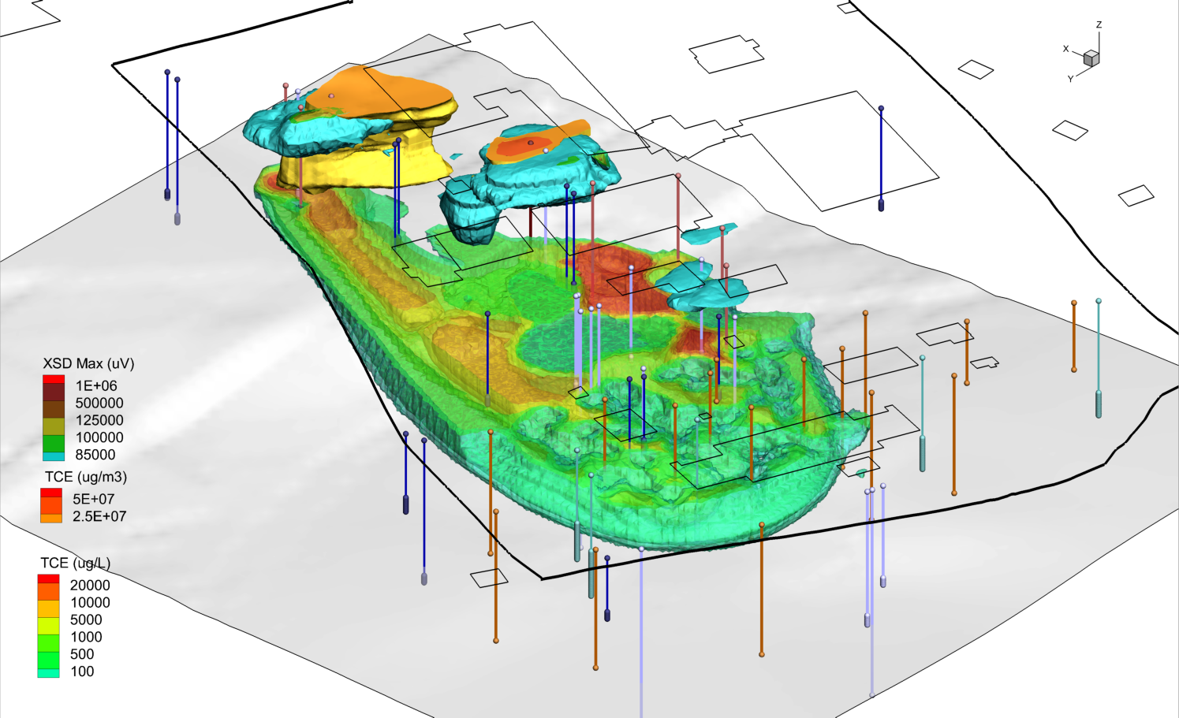

Slide 28
RI Conclusions
TCE is the primary contaminant of concern.
Most of the TCE mass is adsorbed to fine grained soils.
Approximately 77K cubic yards of contaminated soil (>0.8 mg/kg).
Approximately 50M gallons of contaminated overburden groundwater (>5 µg/L).
Minimal impact to bedrock groundwater below the facility.
Large soil gas plume (~52 acres) greater than 100 µg/m³.

Slide 29
RI Conclusions (cont.)
Baseline on-post risks meet USEPA limits for current and future:
  Outdoor worker, utility worker, and trespasser (soil exposures)
  Daycare child (soil and indoor air)
  Indoor workers (soil and indoor air) except for buildings shown below (indoor air):
    CDC
    DPW Storage
    Frost Effects Laboratory
    Main Laboratory and Lab Addition
    Vehicle Storage Building

Slide 30
RI Conclusions (cont.)
Mitigation actions have been implemented and post-mitigation risks meet USEPA limits for current and future:
  Indoor workers (soil and indoor air) for buildings shown below (indoor air):
    CDC
    DPW Storage
    Frost Effects Laboratory
    Main Laboratory and Lab Addition
    Vehicle Storage Building

Slide 31
RI Conclusions (cont.)
Baseline on-post risks do not meet USEPA limits for future:
  Construction worker (vapors in excavation)
  Hypothetical residents (potable use of groundwater, indoor air)
Baseline off-post risks meet USEPA limits for current:
  Workers, customers, and students (indoor air in existing buildings re: vapor intrusion) and hypothetical residents (indoor air in existing buildings) and residents of Dartmouth Housing

Slide 32
RI Conclusions (cont.)
Baseline off-post risks may not meet USEPA limits for hypothetical future:
  Residents at Rivercrest Property (indoor air re: vapor migration and vapor intrusion for future buildings)
Negligible risk to ecological receptors.

Slide 33
What will the Feasibility Study Address?
Vapor intrusion into existing and future buildings and off-site vapor migration.
Exposure to contaminated soil gas by construction workers.
Overburden groundwater as a source of drinking water.

Slide 34
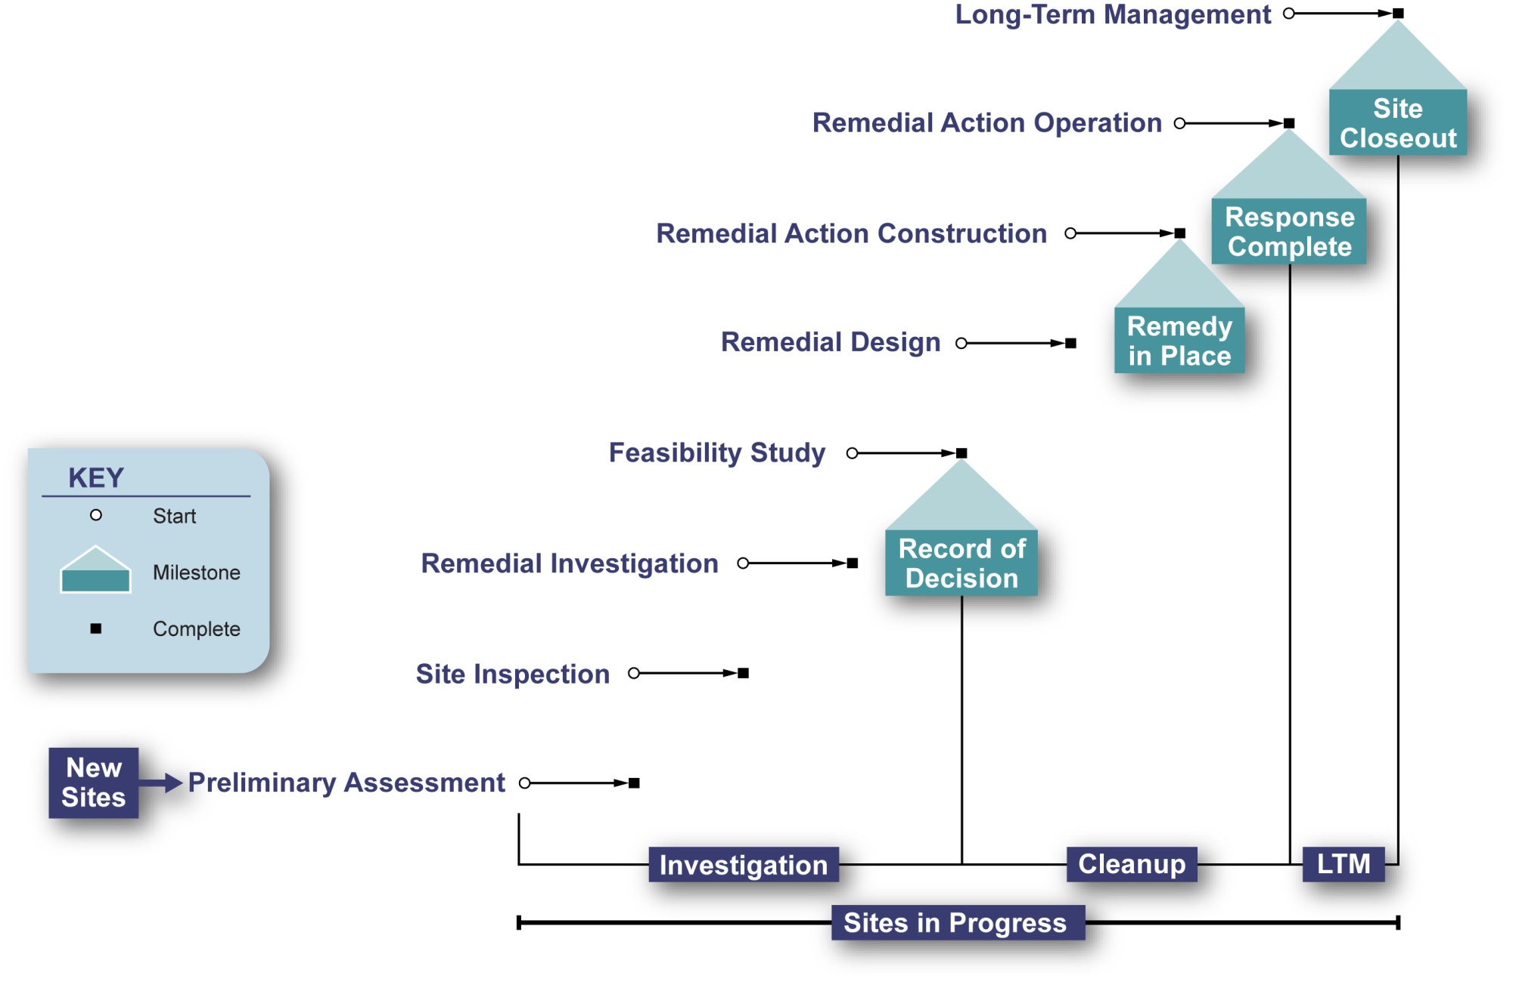
Environmental Restoration Process
Phases and Milestones – Where Are We Now?

Slide 35
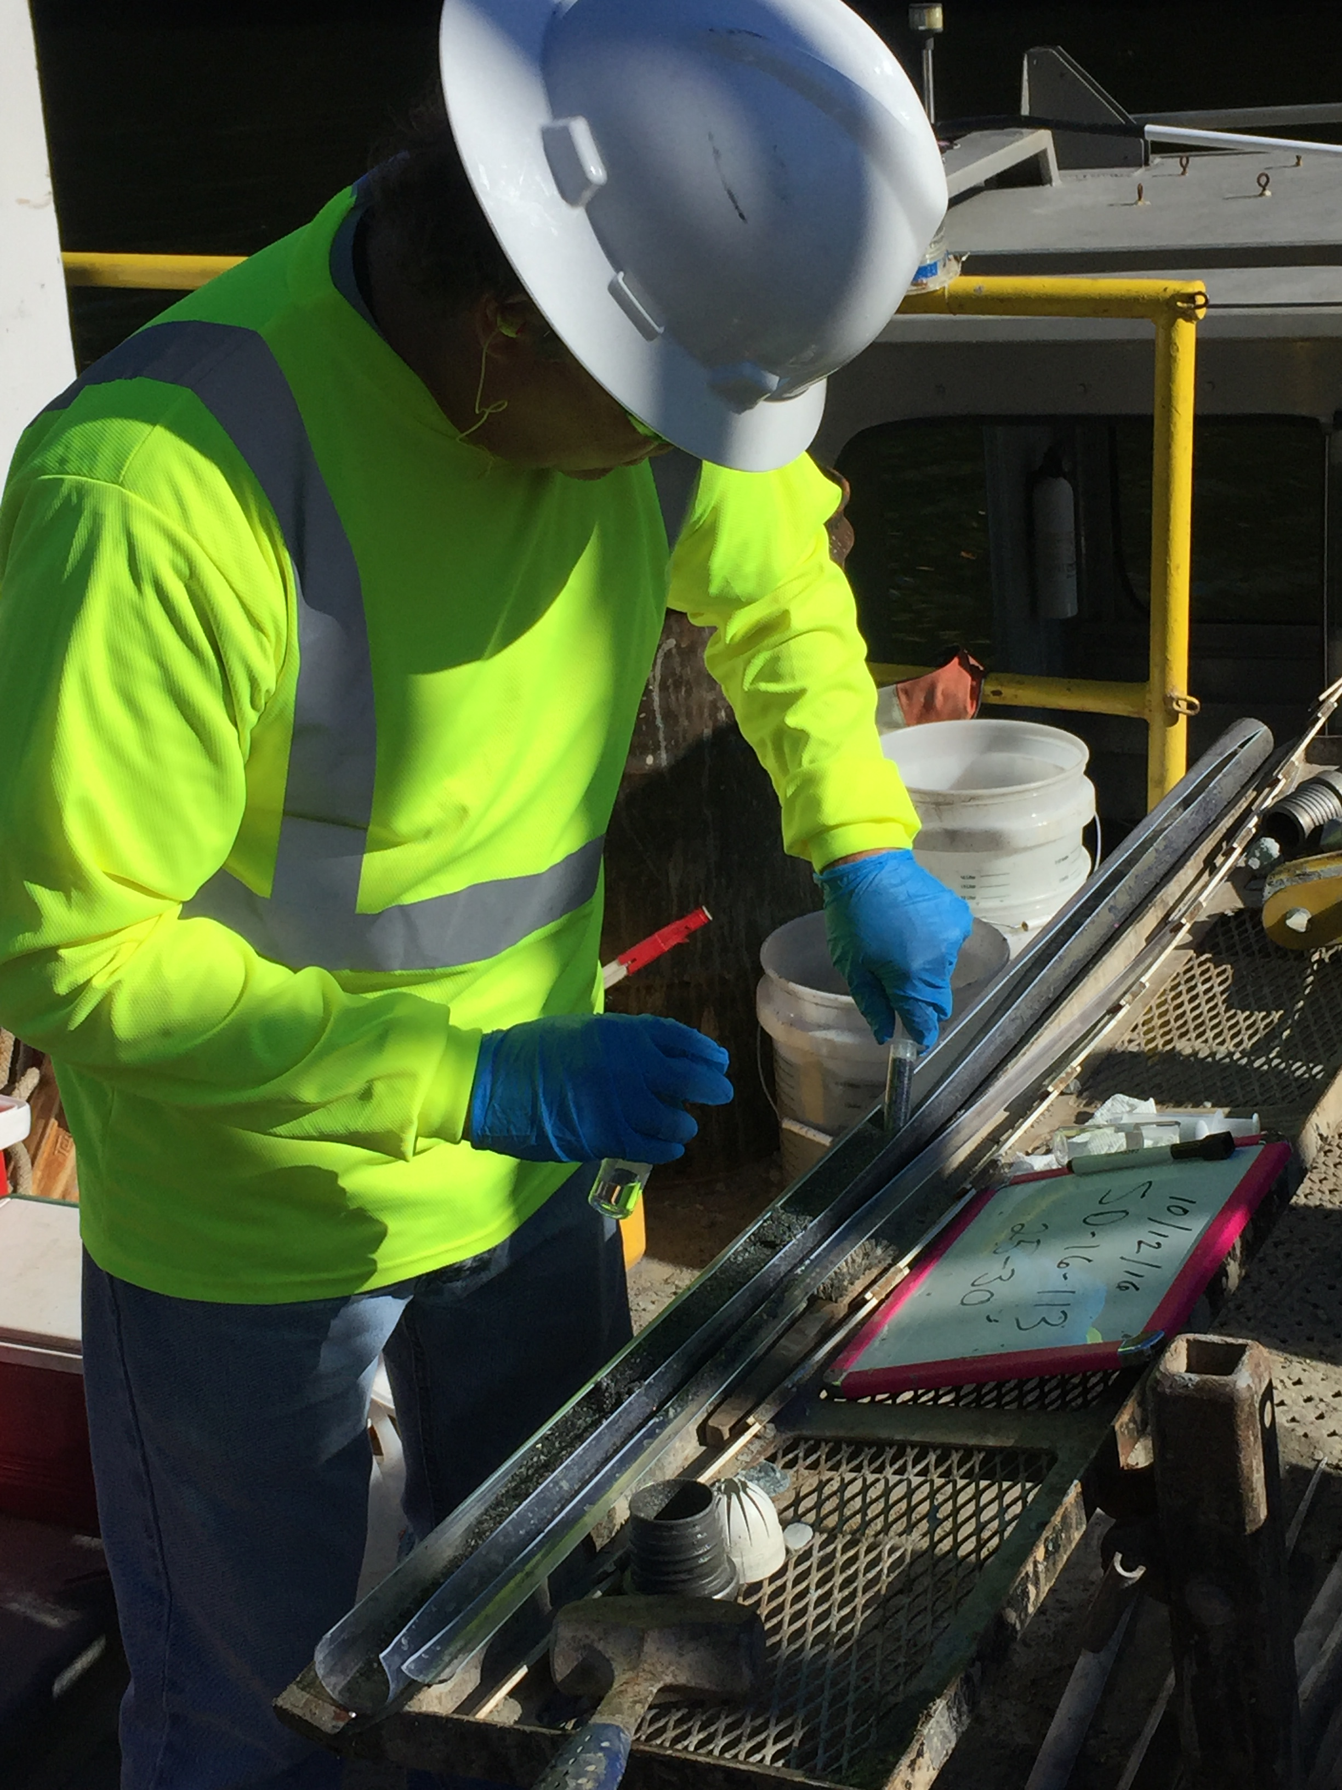
Thank You
Questions or Comments

